Slide 1
Lecture 9
Video Streaming
P2P Networking

Slide 2
Question [from previous exams]
Select those statements that are true.
The “NS record” in DNS maps a hostname to an IP address.
DNS caching happens only at the local DNS server.
The root DNS servers store the IP addresses for all hosts on the Internet.
In a recursive DNS query, the DNS server contacted is responsible for resolving the name completely and returning the final answer to the client.
In DNS, “CNAME record” maps an alias hostname to the canonical hostname.

Slide 3
Question [from previous exams]
Assume you are the founder of a new startup company, called NeuralMesh.com, which provides agentic AI solutions for mesh network configurations. The following are the information for web, email, and DNS servers for your company.
  Web server: www.NeuralMesh.com has IP address: 129.237.120.20
  Mail server: mail.NeuralMesh.com has IP address: 129.237.120.25
  DNS server: dns1. NeuralMesh.com has IP address 129.237.120.10
Part 1: List the resource records (RRs) that need to be provided to the .com TLD registrar. Provide (name, value, type) for each RR.
Part 2: List the RRs that need to be added to the authoritative DNS server at your company.

Slide 4





Video Streaming and CDNs: context
Stream video traffic: major consumer of Internet bandwidth
Challenge 1: heterogeneity
  different users have different capabilities (e.g., wired versus mobile; bandwidth-rich versus bandwidth-poor)
Challenge 2: scale: how to reach ~1B users?
  single mega-video server won’t work
Solution: distributed, application-level infrastructure

Slide 5


Solution 1 - Streaming multimedia: DASH
DASH: Dynamic, Adaptive Streaming over HTTP
server:
  divides video file into multiple chunks
  each chunk stored, encoded at different rates
  manifest file: provides URLs for different chunks
client:
  periodically measures server-to-client bandwidth
  consulting manifest, requests one chunk at a time
    chooses maximum encoding rate sustainable given current bandwidth
    can choose different encoding rates at different points in time (depending on available bandwidth at time)
Internet
client

Slide 6
Solution 1 - Streaming multimedia: DASH
“intelligence” at client: client determines
  when to request chunk (so that buffer starvation, or overflow does not occur)
  what encoding rate to request (higher quality when more bandwidth available)
Internet
client
  where to request chunk (can request from URL server that is “close” to client or has high available bandwidth)
Streaming video = encoding + DASH + playout buffering

Slide 7
Solution 2 - Content distribution networks (CDNs)
challenge: how to stream content (selected from millions of videos) to hundreds of thousands of simultaneous users?
option 1: single, large “mega-server”
  single point of failure
  point of network congestion
  long path to distant clients
  multiple copies of video sent over outgoing link
➔ this solution doesn’t scale

Slide 8


Content distribution networks (CDNs)
challenge: how to stream content (selected from millions of videos) to hundreds of thousands of simultaneous users?
option 2: store/serve multiple copies of videos at multiple geographically distributed sites (CDN)
“enter deep”: push CDN servers deep into many access networks ➔ close to users; Example: Akamai: 350,000 servers deployed in more than 130 countries
“bring home”: smaller number (10’s) of larger clusters in point of presence (POPs) near (but not within) access networks. Example: Fastly

Slide 9




Content distribution networks (CDNs)
CDN: stores copies of content at CDN nodes
  e.g. Akamai stores copies of MadMen
subscriber requests content from CDN
  directed to nearby copy, retrieves content
  may choose different copy if network path congested
…
…
…
manifest file
…
where’s Madmen?
…
…
Notes:
9
Akamai: 100,000+ servers in 1000+ clusters in 1000+ networks in 70+ countries serving trillions of requests a day.
How many people use Netflix?

Slide 10
Content distribution networks (CDNs)
OTT: “over the top”
…
…
Internet host-host communication as a service
…
OTT challenges: coping with a congested Internet
  from which CDN node to retrieve content?
  viewer behavior in presence of congestion?
  what content to place in which CDN node?
…
…
…
Notes:
10
peak load: 7million viewers, 2 Tbytes via

Slide 11


CDN content access: a closer look
Bob (client) requests video https://hulu.com/6Y7B23V
video stored in CDN at https://EdgeKeyCDN.com/NetC6y&B23V
1. Bob gets URL for video https://hulu.com/6Y7B23V
from hulu.com web page
2. resolve https://hulu.com/6Y7B23V
via Bob’s local DNS
1
2
6. request video from
EdgeKeyCDN server,
streamed via HTTP
5
Bob’s
local DNS
server
hulu.com
3. hulu’s DNS returns CNAME for
https://EdgeKeyCDN.com/NetC6y&B23V
4
3
Hulu’s
authoratative DNS
EdgeKeyCDN.com
EdgeKeyCDN
authoritative DNS

Slide 12
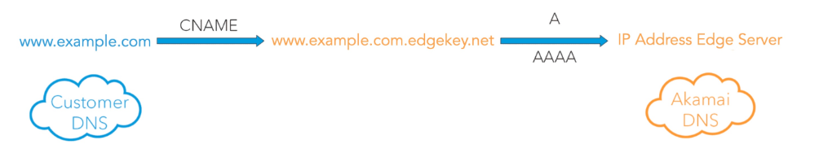
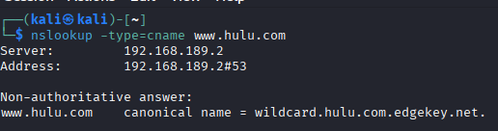
Real-world example
Akamai EdgeKey Servers

Slide 13
P2P Networking
&
Socket Programming

Slide 14
















Peer-to-peer (P2P) architecture
no always-on server
arbitrary end systems directly communicate
peers request service from other peers, provide service in return to other peers
  self scalability – new peers bring new service capacity, and new service demands
peers are intermittently connected and change IP addresses
  complex management
examples: P2P file sharing (BitTorrent)
mobile network
national or global ISP
local or regional ISP
home network
content
provider
network
datacenter
network
enterprise
network

Slide 15
File distribution: client-server vs P2P
Q: how much time to distribute file (size F) from one server to N peers?
  peer upload/download capacity is limited resource
u_{s}: server upload capacity
d_{i}: peer i download capacity
file, size F
u₁
d₁
u₂
u_{s}
d₂
server
d_{i}
u_{N}
network (with abundant
bandwidth)
u_{i}
d_{N}
u_{i}: peer i upload capacity

Slide 16
File distribution time: client-server
server transmission: must sequentially send (upload) N file copies:
  time to send one copy: F/u_{s}
  time to send N copies: NF/u_{s}
F
u_{s}
d_{i}
network
client: each client must download file copy
  d_{min} = min client download rate
  max client download time: F/d_{min}
u_{i}
time to distribute F
to N clients using
client-server approach
D_{c-s} > max{NF/u_{s,},F/d_{min}}
increases linearly in N

Slide 17
File distribution time: P2P
server transmission: must upload at least one copy:
  time to send one copy: F/u_{s}
F
u_{s}
client: each client must download file copy
  max client download time: F/d_{min}
d_{i}
network
u_{i}
clients: as aggregate must download NF bits
  max upload rate (limiting max download rate) is u_{s} + Σu_{i}
time to distribute F
to N clients using
P2P approach
D_{P2P} > max{F/u_{s,},F/d_{min,},NF/(u_{s} + Σu_{i})}
increases linearly in N …
… but so does this, as each peer brings service capacity

Slide 18
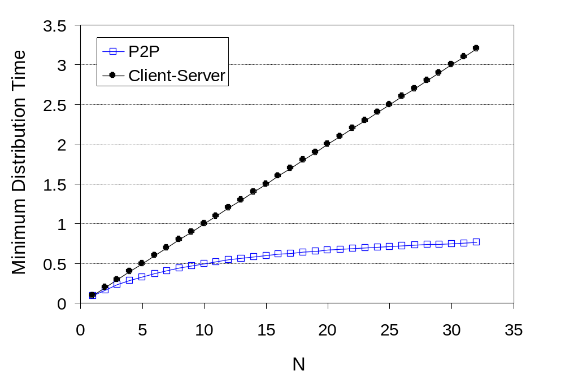
Client-server vs. P2P: example
client upload rate = u, F/u = 1 hour, u_{s} = 10u, d_{min} ≥ u_{s}

Slide 19


P2P file distribution: BitTorrent
file divided into chunks
peers in torrent send/receive file chunks
tracker: tracks peers
participating in torrent
torrent: group of peers exchanging chunks of a file
Alice arrives …
… obtains list
of peers from tracker
… and begins exchanging
file chunks with peers in torrent

Slide 20


P2P file distribution: BitTorrent
peer joining torrent:
  has no chunks, but will accumulate them over time from other peers
  registers with tracker to get list of peers, connects to subset of peers (“neighbors”)
while downloading, peer uploads chunks to other peers
peer may change peers with whom it exchanges chunks
churn: peers may come and go
once peer has entire file, it may (selfishly) leave or (altruistically) remain in torrent

Slide 21
BitTorrent: requesting, sending file chunks
Requesting chunks:
at any given time, different peers have different subsets of file chunks
Alice requests missing chunks from peers, rarest first
Sending chunks: tit-for-tat
Alice sends chunks to those four peers currently sending her chunks at highest rate
  other peers are choked by Alice (do not receive chunks from her)
  re-evaluate top 4 every few seconds
every few seconds: randomly select another peer, starts sending chunks
  “optimistically unchoke” this peer
  newly chosen peer may join top 4

Slide 22
BitTorrent: tit-for-tat
(1) Alice “optimistically unchokes” Bob
(2) Alice becomes one of Bob’s top-four providers; Bob reciprocates
(3) Bob becomes one of Alice’s top-four providers
higher upload rate: find better trading partners, get file faster !

